Slide 1
JoVAC Mini Project
Measuring Cluster Goodness

Slide 2
Mentors Team Members(Vision of US)
Mr.Rahul Pradhan(CEA dept) Prachi Agrawal
Mr. Ashutosh(CEA Dept) Priya
Ms. Arushi Mangla(MamaEarth) Dimpal
Shivani Chaudhary
Yashasvi Gupta
(BTech, CSE, 3rd year)

Slide 3
Problem Statement
Use K-Means clustering on loan-train dataset with value of k as 3 and 4. And validate using silhouette clustering which value of k defines good cluster model.

Slide 4
System requirement
4GB RAM
Run on Jupyter notebook
Implementation in python

Slide 5
Solution Steps
Load dataset
Perform EDA
Find and remove null values by dropping columns(since data has less number of null values)
Check for Outliers and remove using IQR
Encoded categorical variables
Used LabelEncoder from sklearn.preprocessing library
Balancing dataset
Used oversampling and smote for handling imbalance dataset
Standardization
Before applying K-Means, data should be in standard scale, used MinMaxScaler
Finally apply K-Means

Slide 6
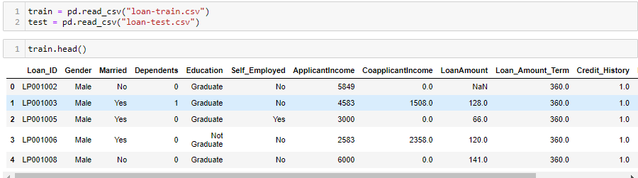
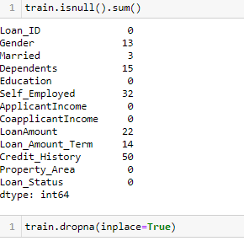
Reading dataset in jupyter notebook
Load dataset and view few top rows
Show number of rows having null values and then drop them all

Slide 7
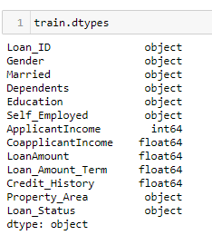
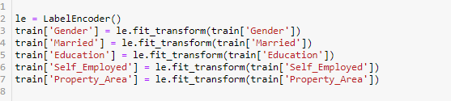
Categorical Encoding
Finding Categorical features(dtypes=object)
Apply encoding

Slide 8
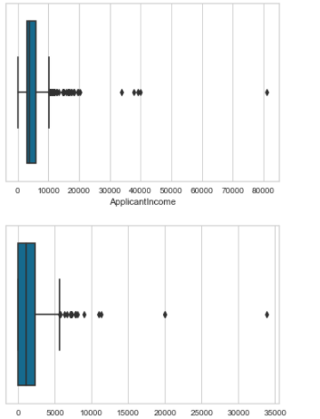

Treating Outliers
ouliers
Outlier removal

Slide 9

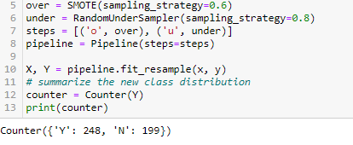
Handling Imbalance Dataset
Imbalance dataset
Apply smote and random under sampling for balancing

Slide 10
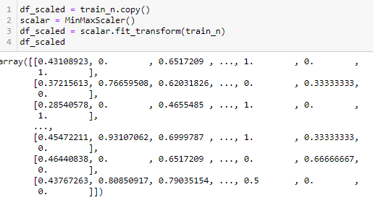
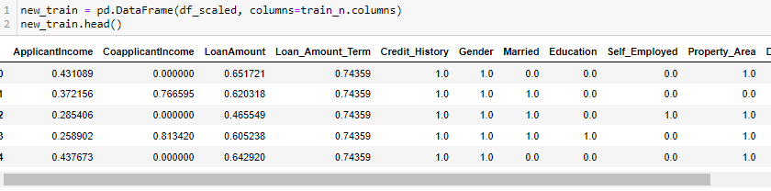
Standardization
Apply MinMaxScaler

Slide 11

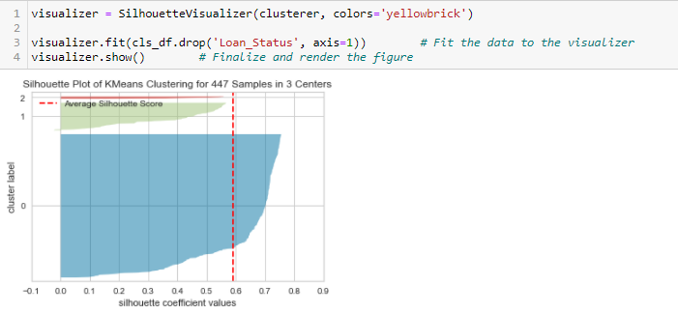
Apply Kmeans
Use k=3
Generate silhouette graph

Slide 12
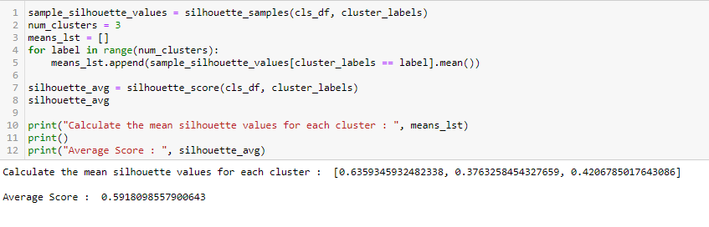
Calculate the mean silhouette values for each cluster, as well as the overall mean silhouette for the cluster model

Slide 13
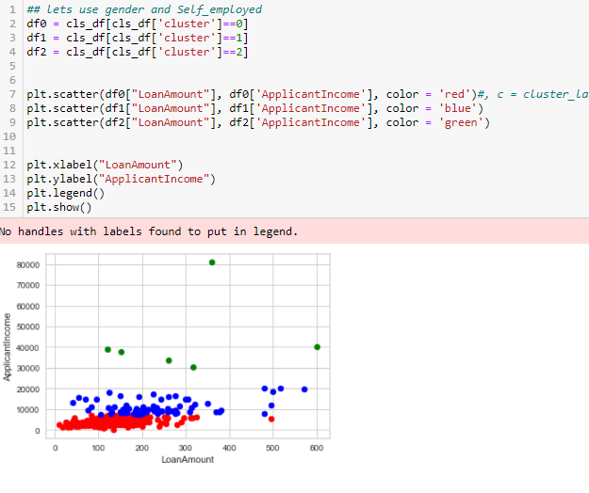
Provide a two-dimensional scatter plot, using variables of your choice, with an overlay of cluster membership. Choose variables that result in an interesting plot. Note where the cluster boundaries are close, and where they are not so close

Slide 14

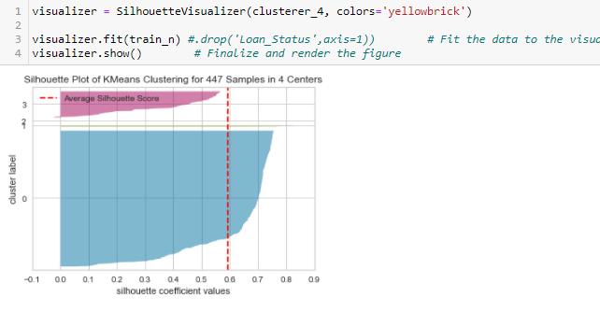
Repeated for k = 4

Slide 15
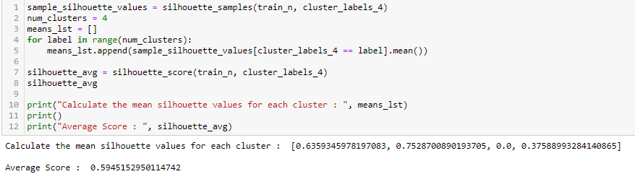
Calculate the mean silhouette values for each cluster, as well as the overall mean silhouette for the cluster model

Slide 16
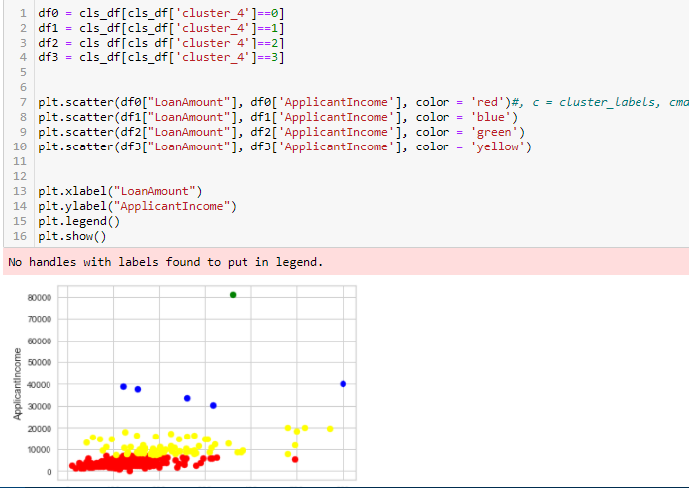
Provide a two-dimensional scatter plot, using variables of your choice, with an overlay of cluster membership

Slide 17
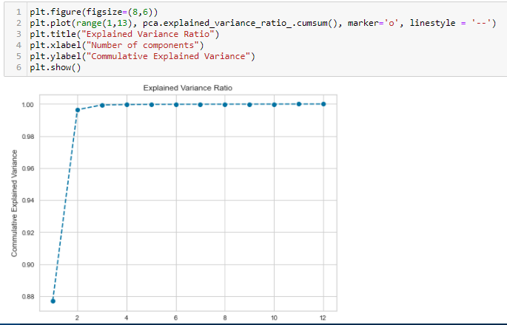
In last Tried to apply PCA to improve model and find n=2 best fit

Slide 18
References
sklearn.cluster.KMeans — scikit-learn 0.24.2 documentation
sklearn.metrics.silhouette_score — scikit-learn 0.24.2 documentation
SMOTE for Imbalanced Classification with Python (machinelearningmastery.com)
Quick Start — Yellowbrick v1.3.post1 documentation (scikit-yb.org)

